Slide 1
D.C Taxi Trips
Group 6: Jiachen Sands, Zeqiu Zhang
Spring 2022

Slide 2
D.C Taxi Trips
01
02
03
04
Project Idea
Data Source
AWS Services
Demo

Slide 3
Project Idea
A
Traditionally, taxi fares are fixed and have not been allowed to change with regard to demand or availability
Department of For-Hire Vehicles (DFHV) seeks to introduce a dynamic pricing system
Analyze how different service fees affect the total amount through data visualization techniques
What variables should be consider in the dynamic pricing system
A data visualization website for users to explore datasets
B

Slide 4
Data
 | Source | Description | Variables
 | Kaggle https://www.kaggle.com/bvc5283/dc-taxi-trips?select=taxi_final.csv | 12 Millions Full taxi trips records for year 2017 | Categorical Variables: 4 (Provider Name, Origin Location) Numerical Variables: 8 (Milage, Duration…) Dependent Variable: Total Amount

Slide 5




AWS Services Part 1
IAM & MFA
2 IAM users (EC2, S3)
Role (Allows EC2 instance to access S3 bucket)
S3 Buckets
Store Raw Data
Host a static webpage
EC2 Instance
Deployed Python Code
Application Load Balancer
Distribute traffic between instances
Forward 443 to 8888 (public to internal)
Installed ACM Certificate (Scale purpose)
Notes:
Security perspective - ec2 can be comprised so installed certificate on ALB
ALB Target group - Forward 443 to 8888

Slide 6

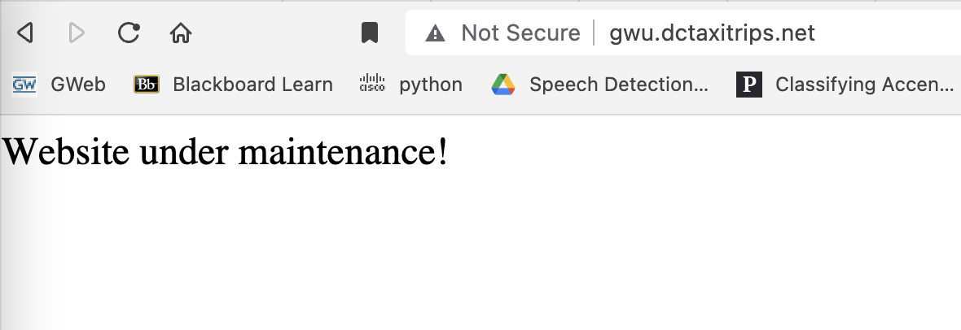
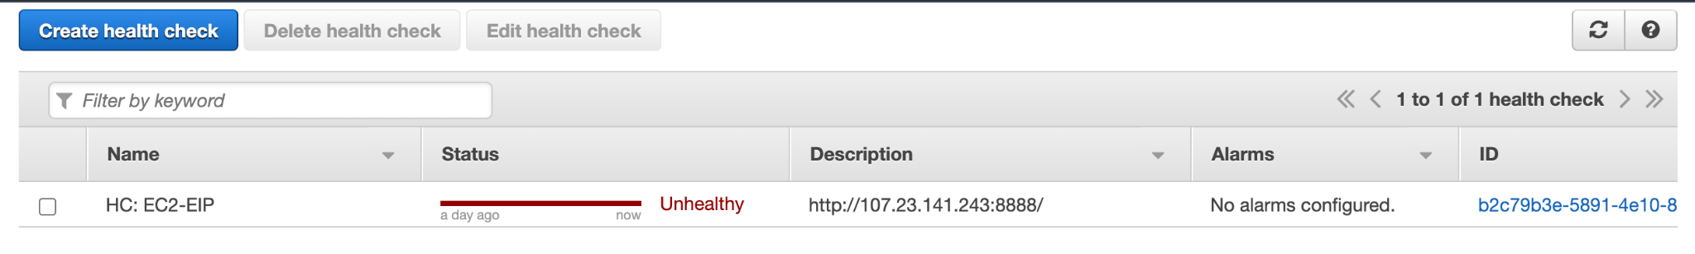
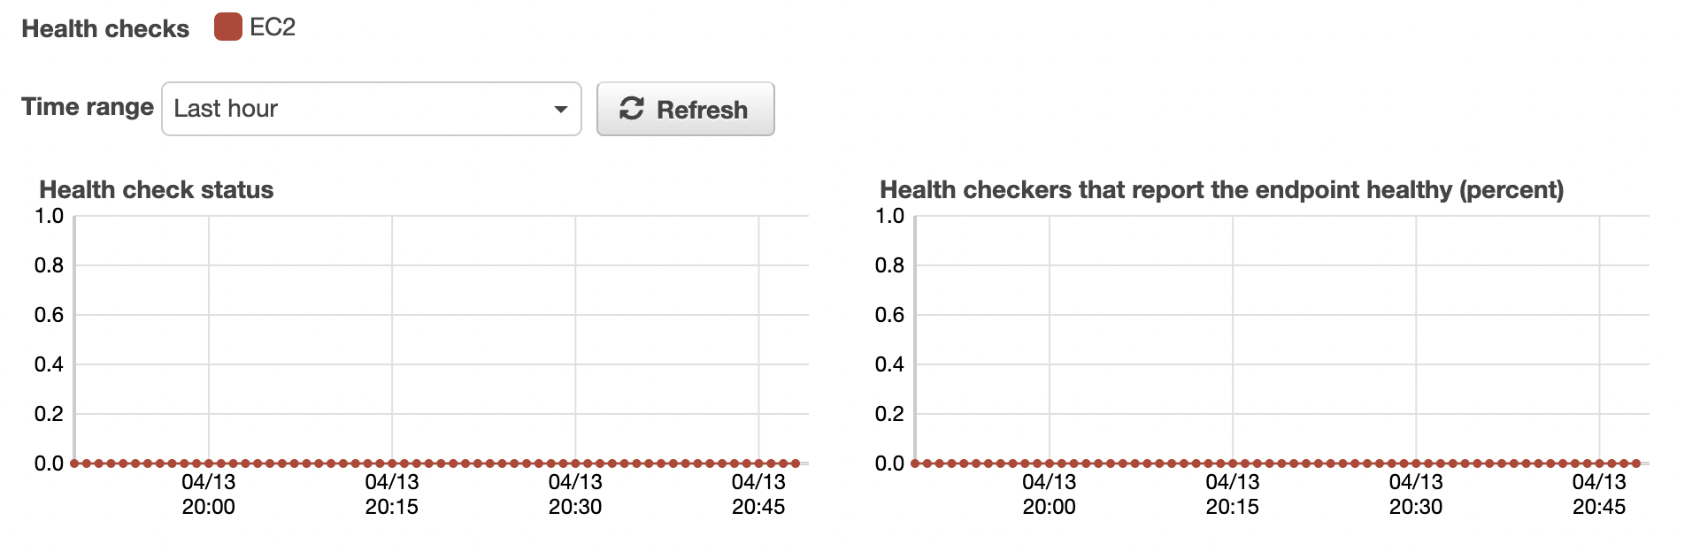
AWS Services Part 2
Route53
Hosted Zone (dctaxitrips.net)
An A Record - gwu.dctaxitrips.net
Failover Routing Policy
Primary Path - Points to ALB
Secondary Path - Points to S3 bucket (gwu.dctaxitrips.net)
Configure Health Check (Primary Path)
Notes:
DNS requires an A record, An A record links to ALB, distribute public traffic to the website . Help the public traffic to access our website based on the IP addresses that A record find

Slide 7
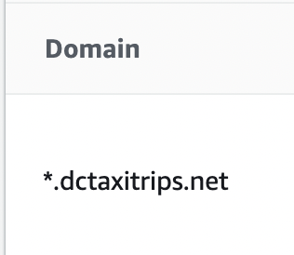

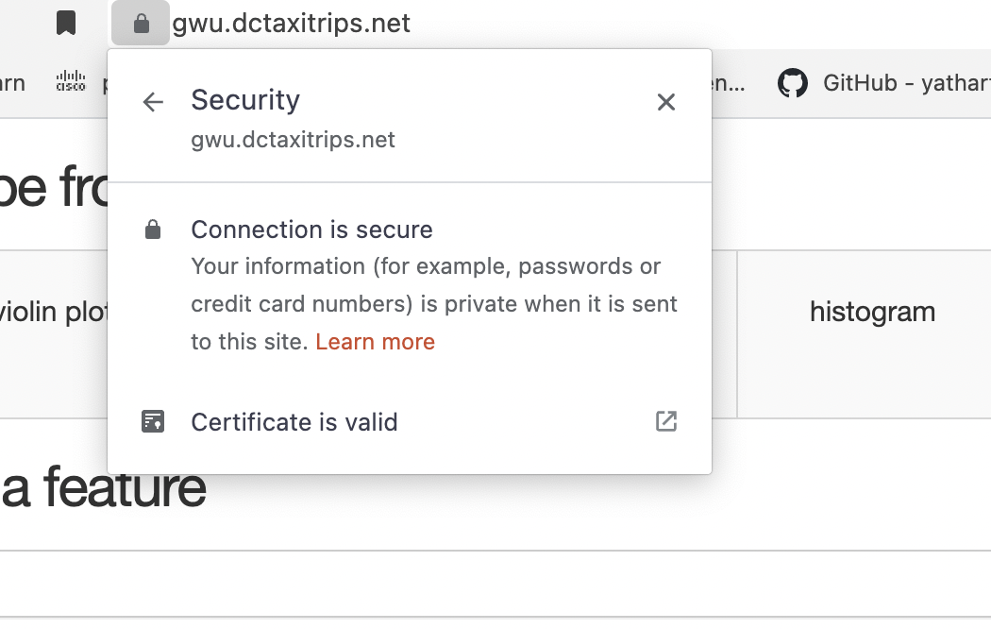

AWS Services Part 3
AWS Certificate Manager (ACM)
Make website trustful
Valid Certificate
Wildcard Certificate
What’s next?
Web Application Firewall (WAF)
Admin Protection
SQL injection
wordpress application
Notes:
* - create any A record in domain dctaxitrips.net
Dctaxistips - root
.net (top level domain, we do not own it)

Slide 8
Demo
Taxi infographics templates. Slidesgo. (n.d.). Retrieved February 22, 2022, from https://slidesgo.com/theme/taxi-infographics#search-taxi&position-1&results-1

